Slide 1
Object-oriented programming
Classes and Objects
__init__() method

Slide 2
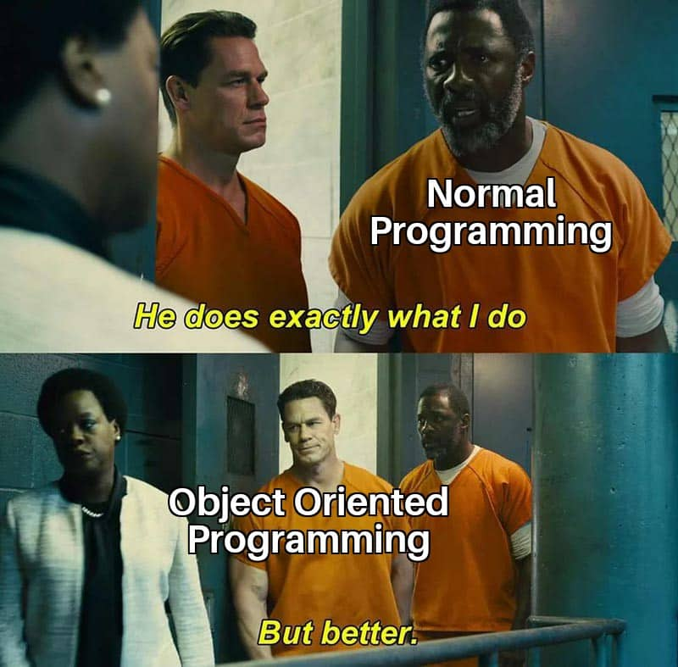
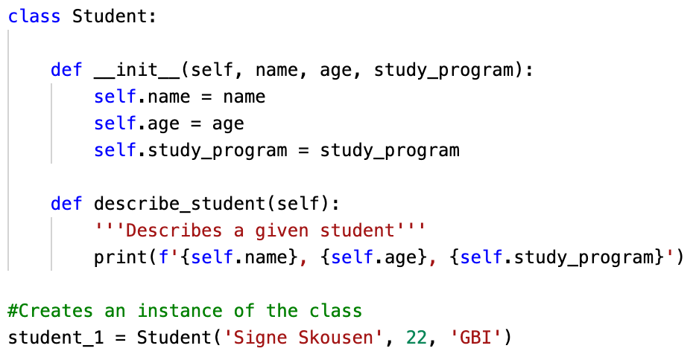
Classes and objects
A class = an overall "category" that defines the general behavior of its objects. E.g. Student
An object = an instance of the class. E.g. Signe Skousen

Slide 3
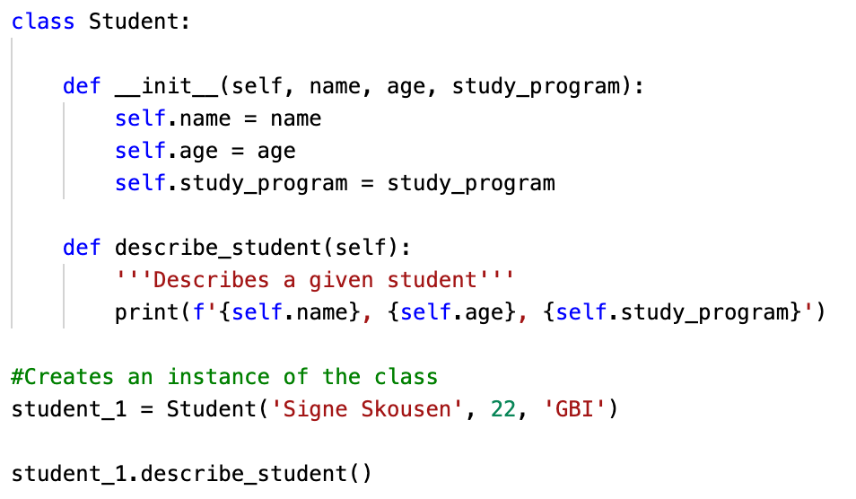
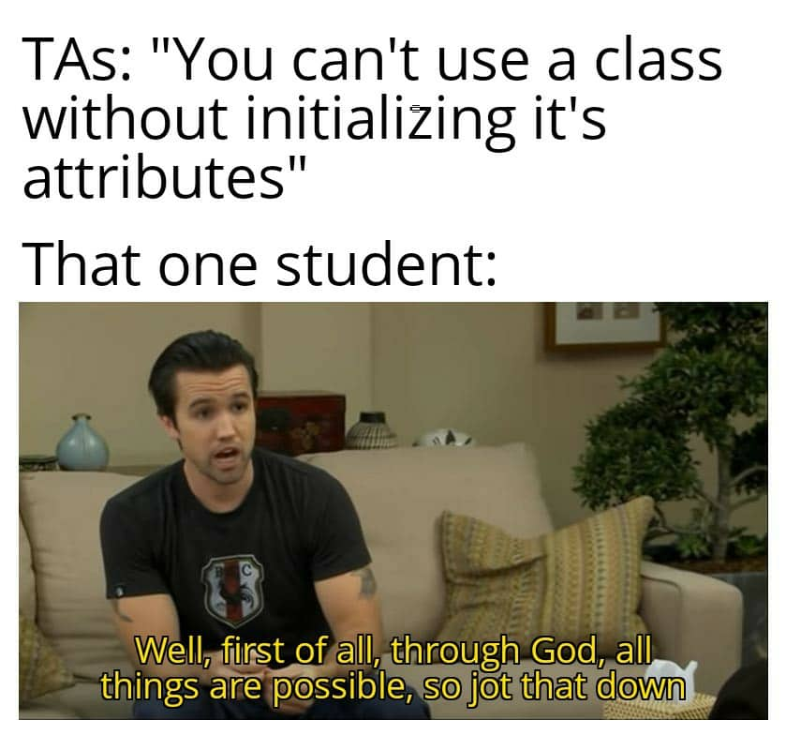
Creating a class, Student, with the parameters: self, name, age and study_program
Use of the __init__() method to initialize the Class, with it's parameters/attributes
Creates a method that can print the name, age and study program of a specific instance.
Creates an instance (object) of the class
Calls the method, describe_student() on the instance, student_1

Slide 4
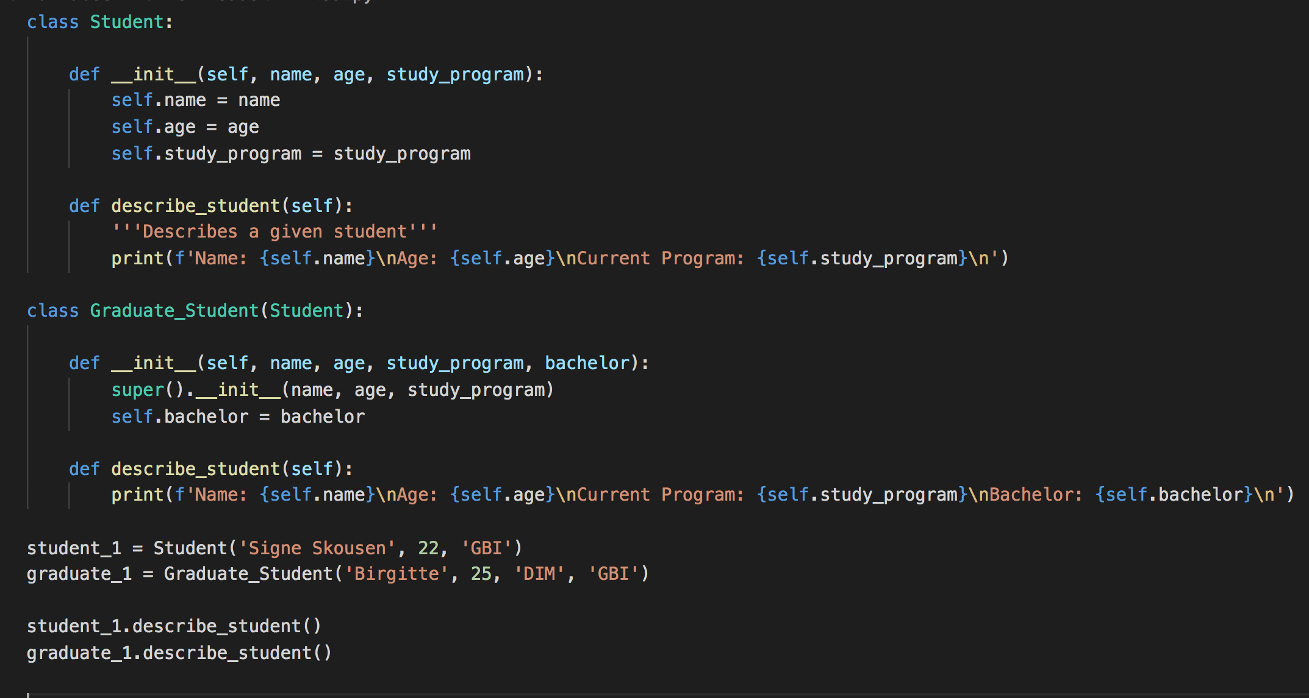
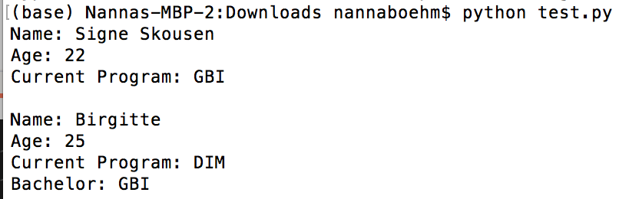
Child classes
A child class can inherit any or all attributes and methods of its parent class and can have attributes and methods of its own
Defining: class Child(Parent)
Initializing attributes from parent: super()__init__(*the attributes you want from parent*)
You can override methods from the parent class

Slide 5
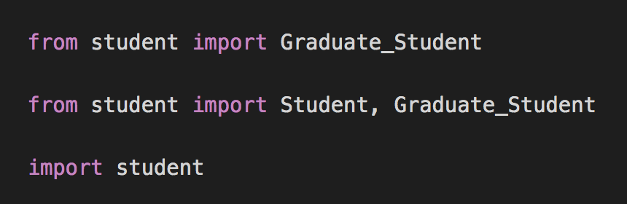
Importing classes
Importing a single class
Importing multiple classes from a module
Importing an entire module

